Slide 1


Machine Learning Capstone Project Supervised Learning: Regression
Topic: Seoul Bike Sharing Demand Prediction
Submitted by:- Subhasis Chattopadhyay
E-mail id: subhasischattopadhyaydbb@gmail.com

Slide 2
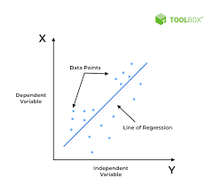
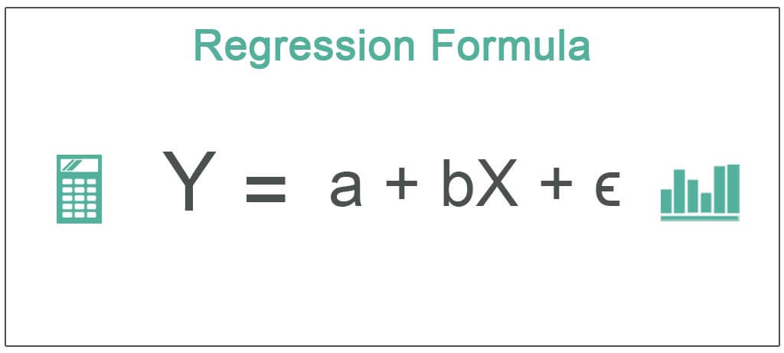
What is Regression?
Regression is defined as a statistical method that helps us to analyze and understand the relationship between two or more variables of interest. The process that is adapted to perform regression analysis helps to understand which factors are important, which factors can be ignored, and how they are influencing each other.
In regression, we normally have one dependent variable and one or more independent variables. Here we try to “regress” the value of the dependent variable “Y” with the help of the independent variables. In other words, we are trying to understand, how the value of ‘Y’ changes w.r.t change in ‘X’.
For the regression analysis is be a successful method, we understand the following terms:
Dependent Variable: This is the variable that we are trying to understand or forecast.
Independent Variable: These are factors that influence the analysis or target variable and provide us with information regarding the relationship of the variables with the target variable.

Slide 3


Topics to Discuss:
Problem Statement
Data description
Data summary
Exploratory Data Analysis
Data pre-processing
Machine Learning model implementation
Model Evaluation
Conclusion

Slide 4

Problem Statement
Currently Rental bikes are introduced in many urban cities for the enhancement of mobility comfort. It is important to make the rental bike available and accessible to the public at the right time as it lessens the waiting time. Eventually, providing the city with a stable supply of rental bikes becomes a major concern. The crucial part is the prediction of bike count required at each hour for the stable supply of rental bikes.

Slide 5
Data Description
The dataset contains weather information (Temperature, Humidity, Windspeed, Visibility, Dewpoint, Solar radiation, Snowfall, Rainfall), the number of bikes rented per hour and date information.
Attribute Information:
Date : year-month-day
Rented Bike count - Count of bikes rented at each hour
Hour - Hour of he day
Temperature-Temperature in Celsius
Humidity - %
Windspeed - m/s
Visibility - 10m
Dew point temperature - Celsius
Solar radiation - MJ/m2
Rainfall - mm
Snowfall – cm
Seasons - Winter, Spring, Summer, Autumn
Holiday - Holiday/No holiday
Functional Day - NoFunc(Non Functional Hours), Fun(Functional hours)

Slide 6
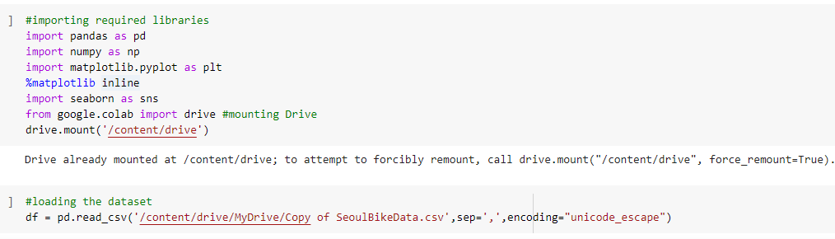
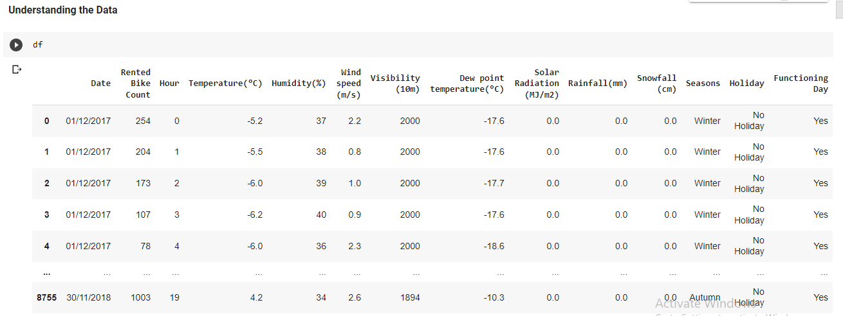
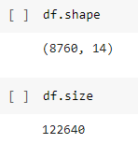
Data Summary
Loading the Dataset
Shape and Size of Data

Slide 7
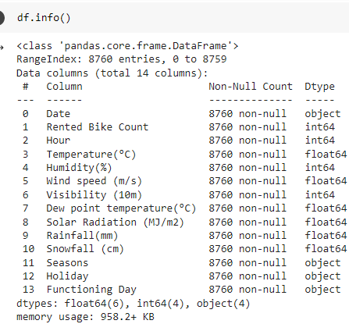
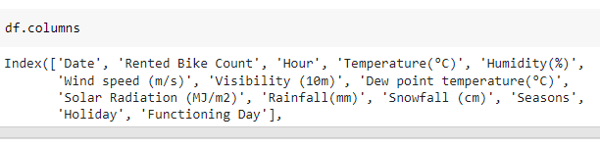
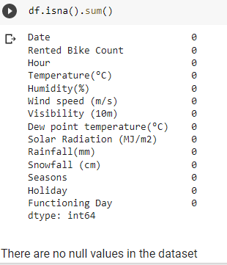
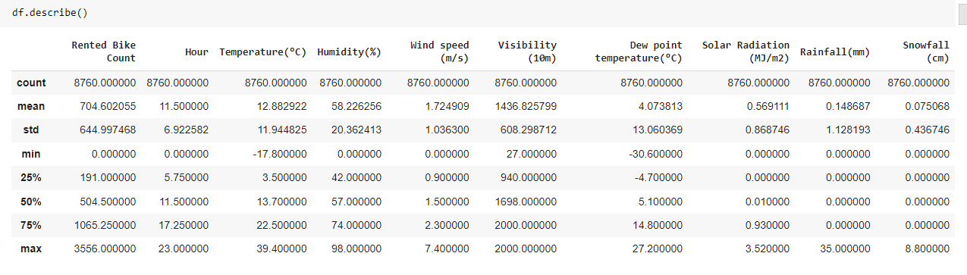
Data Summary (Cont…)

Slide 8
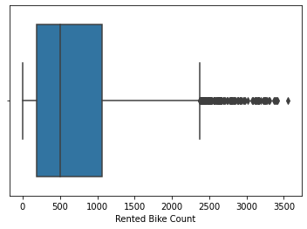
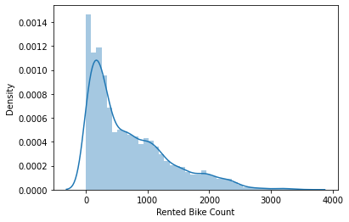
Exploratory Data Analysis(EDA)
Rented Bikes Counts
Boxplot
Density plot

Slide 9
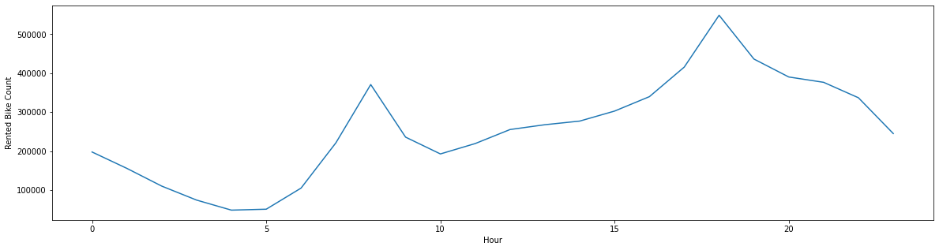
Hour
Lineplot for average bike counts per Hour

Slide 10
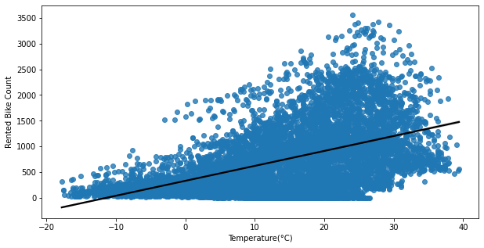
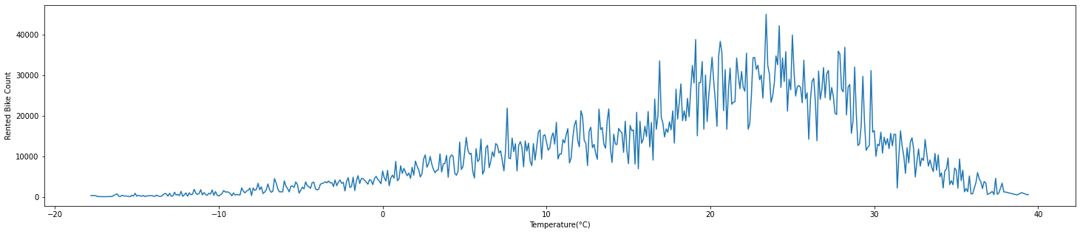
Temperature
Regplot
Lineplot

Slide 11
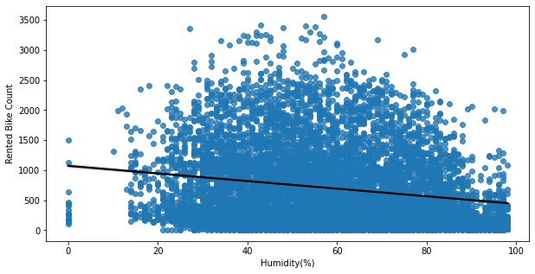
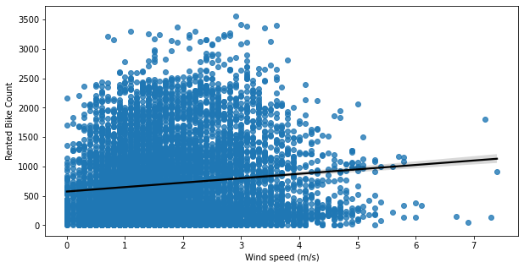
Humidity Wind Speed
Bike Counts VS Humidity
Bike Counts VS Wind speed

Slide 12
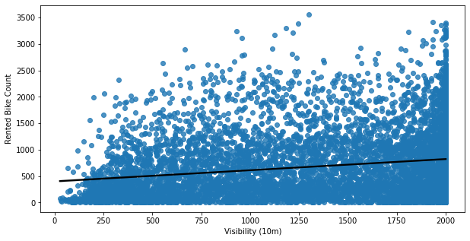
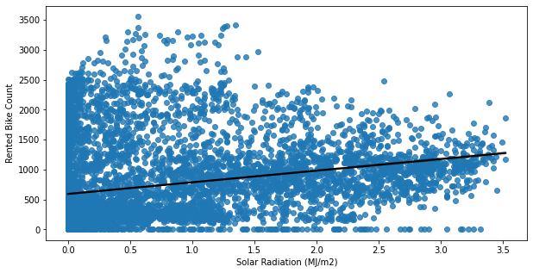
Visibility Solar Radiation
Bike Counts VS Visibility
Bike Counts VS Solar Radiation

Slide 13
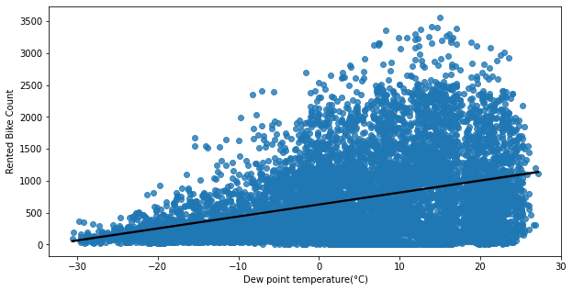
Dew Point Temperature
Bike Counts VS Dew Point Temperature

Slide 14
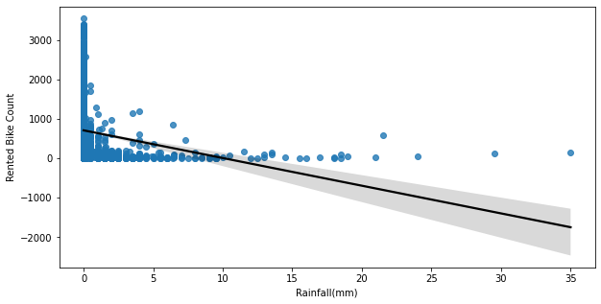
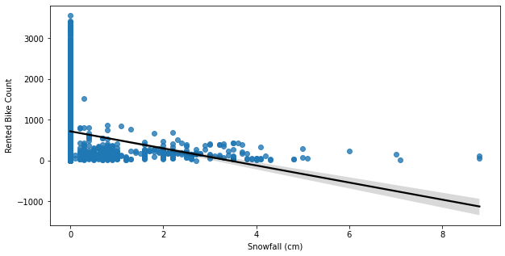
Rainfall Snowfall
Bike Counts VS Rainfall
Bike Counts VS Snowfall

Slide 15
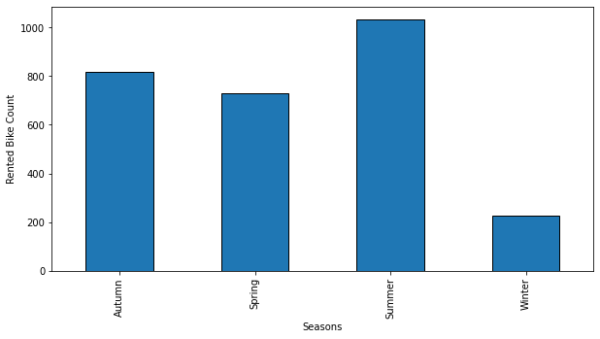
Seasons
Total Bike Counts every Season

Slide 16
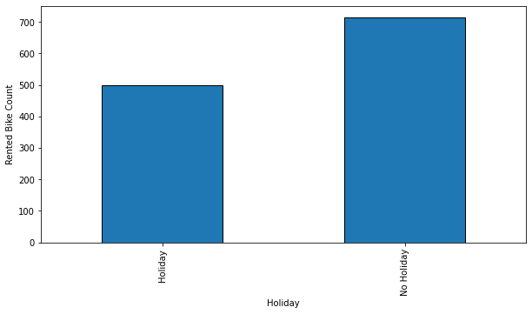
Holiday
Bike Counts on Holidays and Non-Holidays

Slide 17
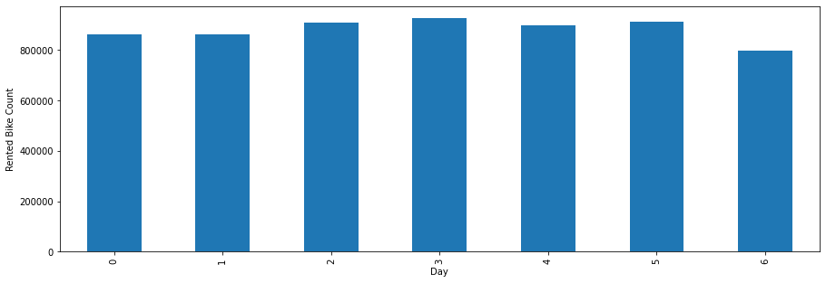
Day
Bike Counts on Every days of week

Slide 18
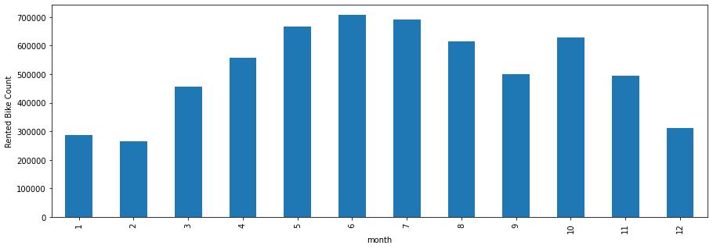
Month
Bike Counts on every Month of Year

Slide 19
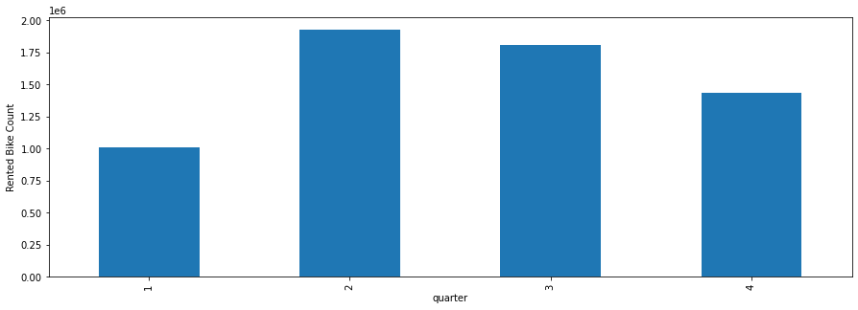
Quarter
Bike Counts on every quarter of year

Slide 20
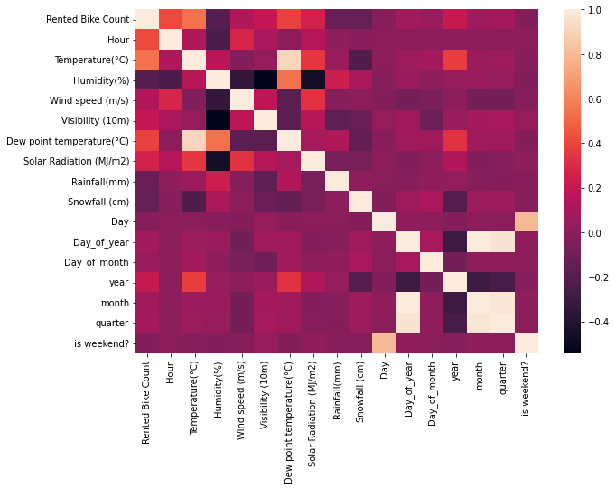
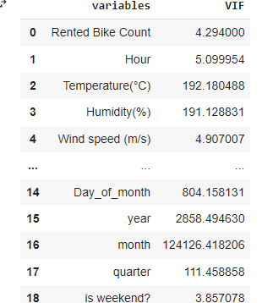
Heatmap and Multi co-linearity

Slide 21
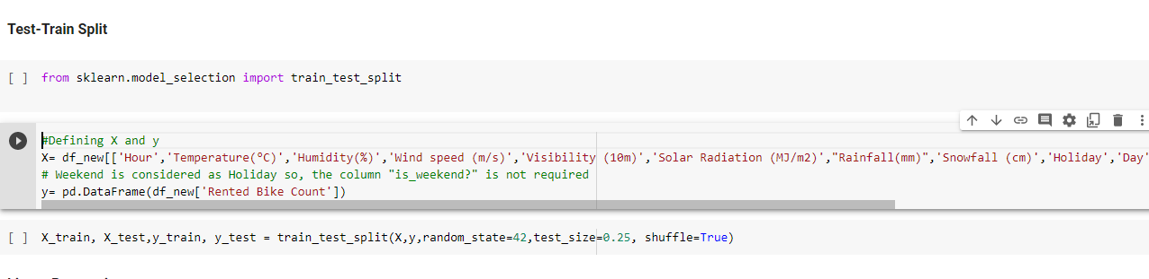
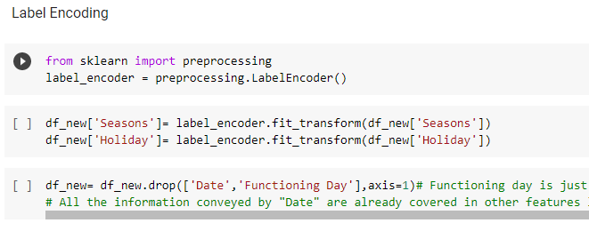
Data Pre-processing
Defining Target Variable, Independent Variable and Splitting them into Test and Train Dataset
Label encoding of Seasons and Holidays

Slide 22
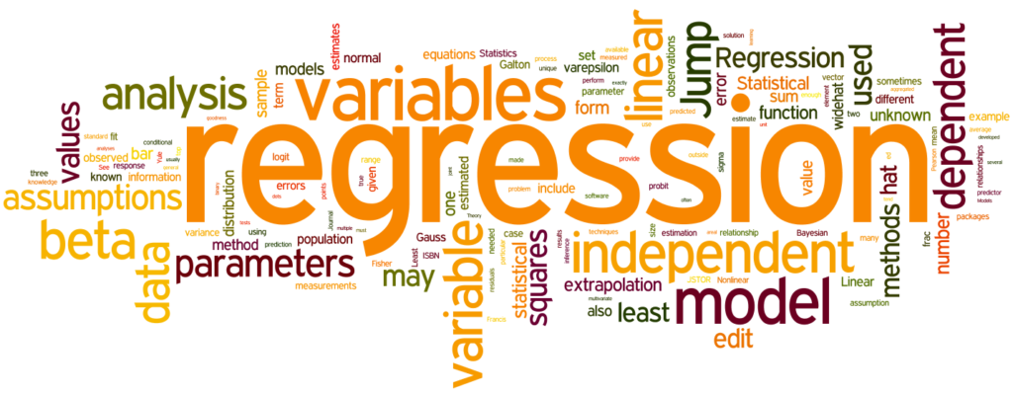
Machine Learning Model Implementation

Slide 23
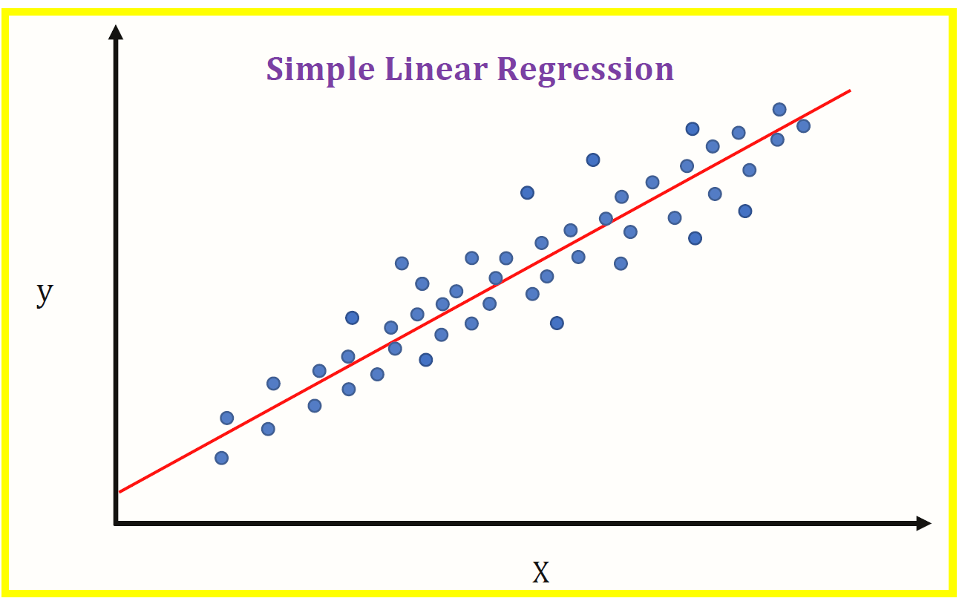
Linear Regression
Linear regression is a basic and commonly used type of predictive analysis. The overall idea of regression is to examine two things: (1) does a set of predictor variables do a good job in predicting an outcome (dependent) variable? (2) Which variables in particular are significant predictors of the outcome variable, and in what way do they–indicated by the magnitude and sign of the beta estimates–impact the outcome variable? These regression estimates are used to explain the relationship between one dependent variable and one or more independent variables. The simplest form of the regression equation with one dependent and one independent variable is defined by the formula y = c + b*x, where y = estimated dependent variable score, c = constant, b = regression coefficient, and x = score on the independent variable.

Slide 24
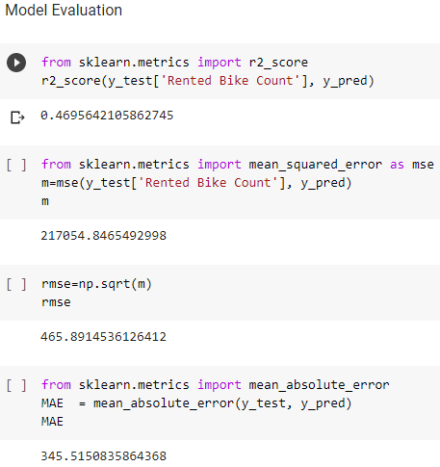
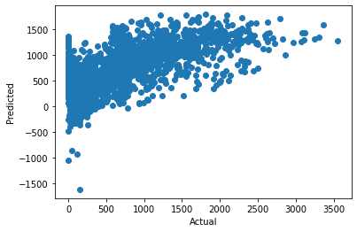
Model Evaluation

Slide 25
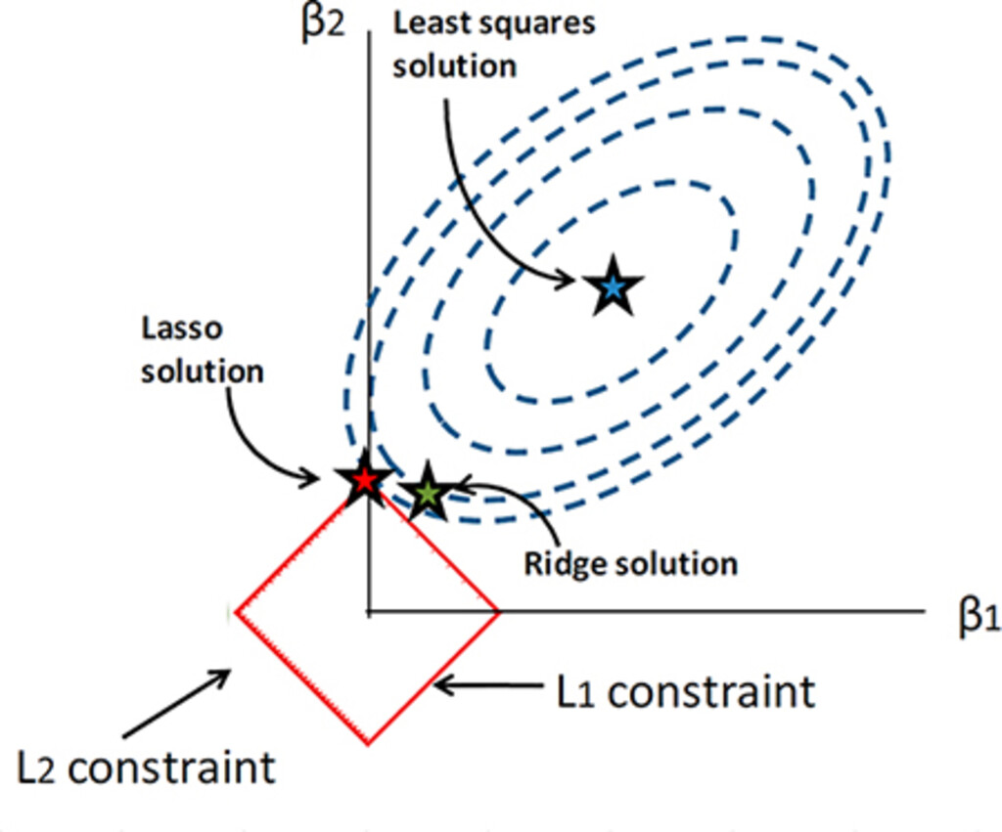
Regularised Linear Regression Lasso Regression
Lasso regression is a type of linear regression that uses shrinkage. Shrinkage is where data values are shrunk towards a central point, like the mean. The lasso procedure encourages simple, sparse models (i.e. models with fewer parameters). This particular type of regression is well-suited for models showing high levels of muticollinearity or when you want to automate certain parts of model selection, like variable selection/parameter elimination.
The acronym “LASSO” stands for Least Absolute Shrinkage and Selection Operator.
L1 Regularization
Lasso regression performs L1 regularization, which adds a penalty equal to the absolute value of the magnitude of coefficients. This type of regularization can result in sparse models with few coefficients; Some coefficients can become zero and eliminated from the model. Larger penalties result in coefficient values closer to zero, which is the ideal for producing simpler models.

Slide 26
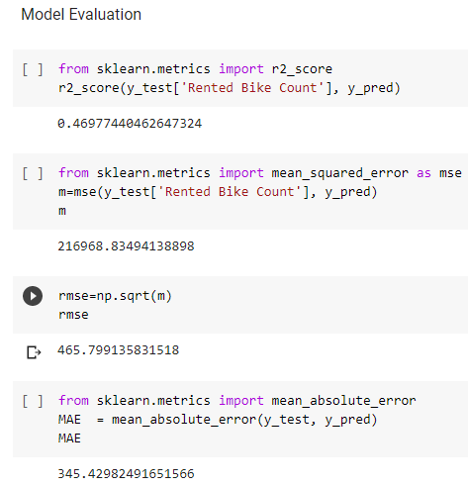
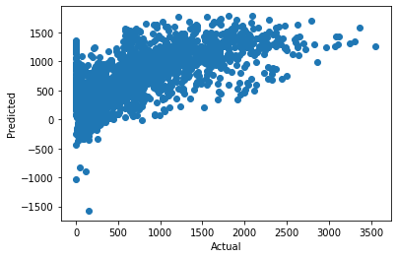
Model Evaluation

Slide 27
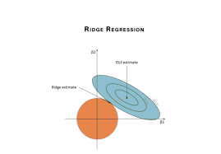
Ridge Regression
Ridge regression is a model tuning method that is used to analyze any data that suffers from multicollinearity. This method performs L2 regularization. When the issue of multicollinearity occurs, least-squares are unbiased, and variances are large, this results in predicted values being far away from the actual values.
The cost function for ridge regression:
Min(||Y – X(theta)||^2 + λ||theta||^2)
Lambda is the penalty term. λ given here is denoted by an alpha parameter in the ridge function. So, by changing the values of alpha, we are controlling the penalty term. The higher the values of alpha, the bigger is the penalty and therefore the magnitude of coefficients is reduced.
It shrinks the parameters. Therefore, it is used to prevent multicollinearity
It reduces the model complexity by coefficient shrinkage

Slide 28
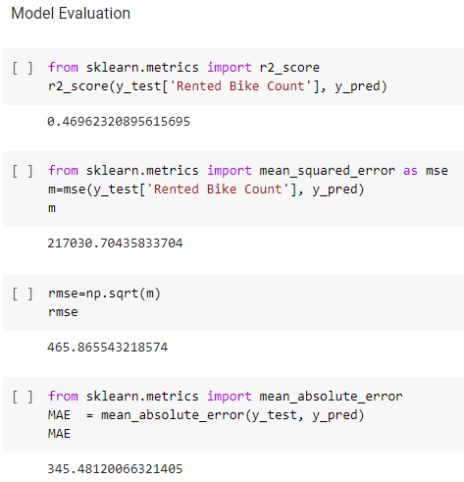

Model Evaluation

Slide 29
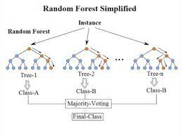
Random Forest
Random forests or random decision forests is an ensemble learning method for classification, regression and other tasks that operates by constructing a multitude of decision trees at training time. For classification tasks, the output of the random forest is the class selected by most trees. For regression tasks, the mean or average prediction of the individual trees is returned. Random decision forests correct for decision trees' habit of overfitting to their training set.

Slide 30
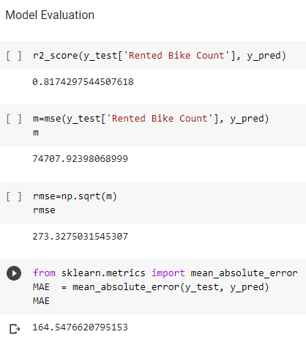
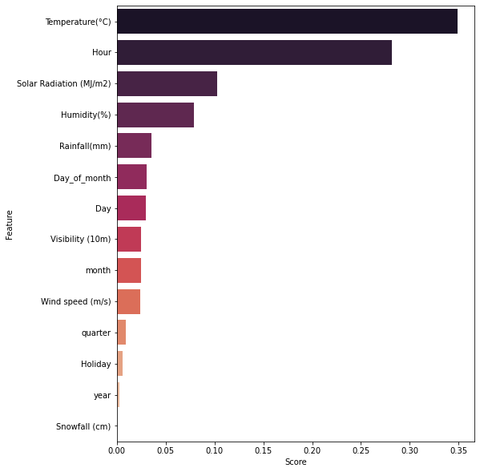
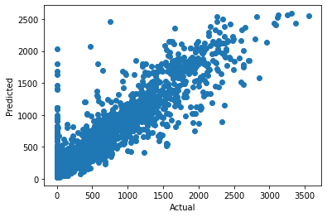
Model Evaluation

Slide 31
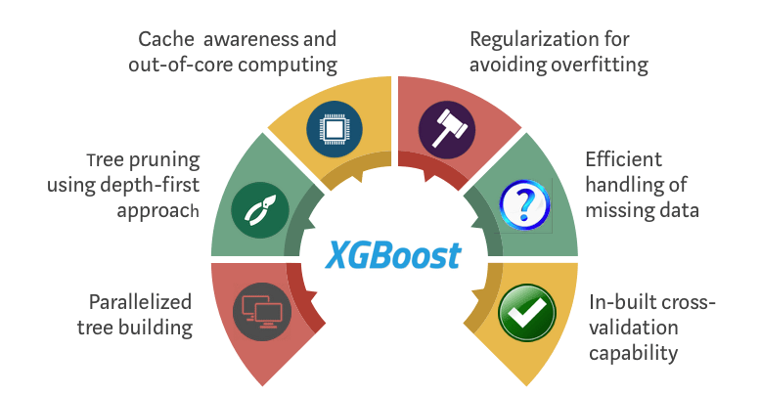
XGBoost
XGBoost is a popular and efficient open-source implementation of the gradient boosted trees algorithm. Gradient boosting is a supervised learning algorithm, which attempts to accurately predict a target variable by combining the estimates of a set of simpler, weaker models.
When using gradient boosting for regression, the weak learners are regression trees, and each regression tree maps an input data point to one of its leafs that contains a continuous score. XGBoost minimizes a regularized (L1 and L2) objective function that combines a convex loss function (based on the difference between the predicted and target outputs) and a penalty term for model complexity (in other words, the regression tree functions). The training proceeds iteratively, adding new trees that predict the residuals or errors of prior trees that are then combined with previous trees to make the final prediction. It's called gradient boosting because it uses a gradient descent algorithm to minimize the loss when adding new models.

Slide 32
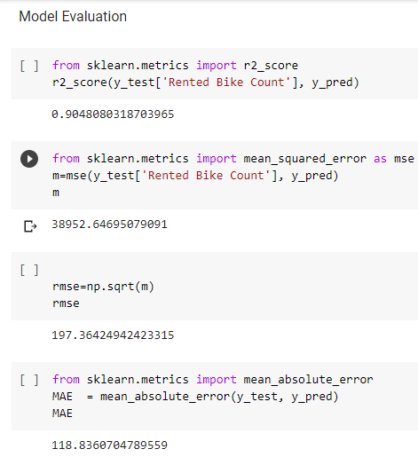
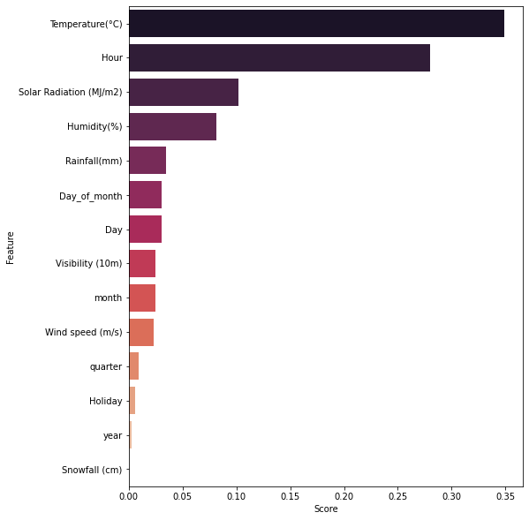
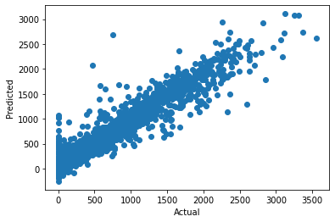
Model Evaluation

Slide 33
Conclusion
As we can see Hyper Parameter Tuned XGBoost ML model performs best with an accuracy of 90%. Total amount of bike rentals increases with the temperature per month. Whereas it seems that the rentals are not much affected by wind speed and humidity, because they are almost constant over the months. This also confirms on the one hand the high correlation between rentals and temperature and on the other hand that nice weather could be a good predictor. So people mainly rent bikes on nice days and optimum temperature. This could be important of planning new bike rental stations.

